Slide 1


Best Practices for Real-time Stream Processing
Fawaz Ghali – Developer Advocate
@fawazghali

Slide 2

Scan QR Code to Win $100 Gift Voucher

Slide 3

About me
Fawaz Ghali
Developer Advocate at Hazelcast
Liverpool, UK
+20 years of experience in the industry, research and academia
PhD in Computer Science
Sub 3 marathoner

Slide 4
What is real-time?
Nanoseconds: A nanosecond (ns) is one billionth of a second.
Microseconds: A microsecond (µs) is one-millionth of a second.
Milliseconds: A millisecond (ms) is one one-thousandth of a second.
Examples:
The camera flash illuminates for 1,000 microseconds, or 1 milliseconds.
Camera shutter speed for 4,000 microseconds or 4 milliseconds.
Avg. human eye blink takes 350 milliseconds (just over 1⁄3 second).
Avg human finger snap takes 150 milliseconds (just over 1⁄7 second).
Hazelcast use-cases: microseconds to milliseconds, milliseconds to seconds

Slide 5

Real-time is everywhere!
While the customer is banking
When the customer is shopping
During a fraudulent event
Before a process breaks
When a patient needs attention
Value
Real-Time
Batch
2010 2020 2030

Slide 6
Hazelcast: Unified Platform
Fast Data
Real-Time Data Platform
Slow Data
Unify all data types
Instantaneous performance
Developer simplicity
Notes:
What if you had a data platform that addresses the challenges of real-time by unifying disparate data sources in a single, high-performance integrated platform.
This unified platform simplifies the development and deployment process, reduces data movement, and eliminates extra moving parts that contribute to failure and downtime.

Slide 7









Hazelcast Versus Other Real-Time Data Platforms
Automated Action
(Recommendations, Alerts, Offers, etc.)
Hazelcast Platform
Stream processing
In-memory data store
ML inference
Data preparation
End-user analytics
End Users
Hazelcast Works Here for Real-Time
Fast, but Not Real-Time
Even Deliver to Existing Infrastructure
Data Preparation for End-User Analytics
Other Real-Time Data Platforms
Data Access,
End Users
Data Sources
Analytics
Waiting Time…
Notes:
Three problems with the other “real-time data platforms”:
They only participate in “real-time” at the very end of the data journey, so does that small contribution count as “real-time”?
They require data to first be written to a data store
They require human intervention for the types of analytics they provide
This means they aren’t really real-time.
Hazelcast can act on data much earlier in the process because it does not require writing to a database first. That’s what “stream processing” is.

Slide 8

Our Integrated Advantage
Fast Data Stores
Stream Processing Engines
In-Memory Stores
ksqlDB
Kafka Streams
Redis
Aerospike
Spark Streaming
VoltDB
MongoDB
HANA
Couchbase
Flink
Cassandra
Kinesis Streams
SingleStore

Slide 9






Modernize Applications via Real-Time Focus From Edge to Data Center to the Cloud
Traditional Stack
Modernized Stack
BENEFITS
Legacy Apps
Legacy Apps
New Apps
New Apps
High-Throughput,
Low-Latency
Database
The Hazelcast Platform
Integrated Batch and Stream Processing with In-Memory Storage
Database
Simplified Deployments
Virtualization (Hypervisor)
Operating System
Containers
Cloud-Native, Multi-Cloud
Operating System
Serverless
Notes:
To illustrate where Hazelcast sits a bit more, on the left you have a traditional tech stack. Nothing special here. Legacy apps sit on top of the database and retrieve the data from the disk as slower speeds.
Now, you’ll recall that we did not mention anything about discarding the database. While we’ve had customers replace their databases with an in-memory data grid, that approach is limited to a small number of use cases. We believe the database is still relevant, but a disk can only spin so fast.
Looking at the modernized stack you will see that Hazelcast sits right in-between the application and the database. It can be embedded in or much closer to the application, thus providing the fast retrieval and write access. And in the background, it is checking back with the database that it has the latest information to support the application.
It’s worth checking out Gartner’s view on modernizing your architecture with regard to a digital integration hub (DIH): https://www.gartner.com/en/documents/3880263/innovation-insight-the-digital-integration-hub-turbochar

Slide 10



Core Platform
The Hazelcast Platform
Stream and Batch Processing Engine
Compute
Transform
Combine
Stream
ML Inference
In-Memory Data Store
Storage
Persistence
Notes:
Core Platform
Core platform is cloud ready, memory first, real-time and batch stream processing -
Kappa architecture - all data flows through a single path, using a stream processing system. Supported near real time analytics
Stream processing added to original in-memory storage, messaging, compute component – benefits streaming of real-time events
In-memory store benefits low latency enrichment
DAG API delivers flexibility and manipulation of data
Highly fault tolerant

Slide 11










Data Sources and Sinks
Kafka
The Hazelcast Platform
Kafka
MQ
MQ
Stream and Batch Processing Engine
Compute
IoT
Continuous
Business Events
Pipeline
Alerts
Custom Connector
Interactive Analytics
Enterprise Applications
Transform
Combine
Stream
ML Inference
Enterprise Applications
Hazelcast
In-Memory Data Store
Storage
Actionable
Context
Hazelcast
File Watcher
Databases
Socket
HDFS, S3, NoSQL
Persistence
Database Events
Files
Sources
Sinks
Notes:
Ingest data from multitube of data sources and formats, be it;
Kafka streams
IOT devices M
Messaging
Proprietary Unified file connector OOTB
Data sources – supports Filesys, Amazon S3, Google cloud storage etc…
Data formats - JSON, Avro, CSV etc…
Data sinks
Sink connectors – S3, Kinesis, JDBC and JSON – enabling the pushing of processed/contextualized data.
Recipient services – Enterprise apps, analytics engines, databases, alerting applications

Slide 12
Interfaces
End User Applications
Microservice Servlet
Microservice Servlet
Microservice Servlet
Microservice Servlet
Microservice Servlet
Microservice Servlet
Analytics
Client
Java Client
C#/.Net Client
C++ Client
JS Client
Python Client
Go Client
JDBC
SQL
SQL
SQL
SQL
SQL
Nearcache
Nearcache
Nearcache
Nearcache
Nearcache
The Hazelcast Platform
Stream and Batch Processing Engine
Compute
Transform
Combine
Stream
ML Inference
In-Memory Data Store
Storage
Persistence
Notes:
Interfaces
Multi-language support for microservices: Java, C#, Go, NodeJS, Dynacache, Memcache, Quarkus
SQL Query interface provides familiarity with industry – standard language
SQL Joins, sorting and aggregation on the roadmap

Slide 13
Systems of Record
The Hazelcast Platform
Stream and Batch Processing Engine
Compute
Transform
Combine
Stream
ML Inference
In-Memory Data Store
Storage
Persistence
Systems of Record
Notes:
Systems of Record
Integration with RDBMS, Warehouses, Datalakes, file system
Synchronous and asynchronous replication of data with cache
Application updates in the platform can be reflected to the systems of record with our write-through capability.

Slide 14
Hazelcast Architecture
End User Applications
Microservice Servlet
Microservice Servlet
Microservice Servlet
Microservice Servlet
Microservice Servlet
Microservice Servlet
Analytics
Client
Java Client
C#/.Net Client
C++ Client
JS Client
Python Client
Go Client
JDBC
SQL
SQL
SQL
SQL
SQL
Nearcache
Nearcache
Nearcache
Nearcache
Nearcache
Kafka
The Hazelcast Platform
Kafka
MQ
MQ
Stream and Batch Processing Engine
Compute
IoT
Continuous
Business Events
Pipeline
Alerts
Custom Connector
Interactive Analytics
Enterprise Applications
Transform
Combine
Stream
ML Inference
Enterprise Applications
Hazelcast
In-Memory Data Store
Storage
Actionable
Context
Hazelcast
File Watcher
Databases
Socket
HDFS, S3, NoSQL
Persistence
Database Events
Files
Sources
Sinks
Systems of Record
Notes:
Looking at this diagram - streams horizontal and end user requests vertical.
Constitutes a kappa architecture. Streaming and in-memory processing
Streams - left to right
Continuous flow of data from machines, enterprise apps, smart sensors, IOT for example.
Enables you to respond to data quickly, analyse, identify insights or patterns of data
Push to another recipient/destination/sink
This is about very fast data access and processing - all in memory - then providing the output/answer

Slide 15
Traditional Stream Processing Architecture
Streaming architectures require an event streaming database.
But bolted-on, external data stores add latency and complexity.
Stream Processing Ecosystem
E.g., Spark Driver, Spark Master, HDFS, NameNode, Zookeeper, etc.
System Complexity
Streaming Sinks
Streaming Sources
Stream Processing Engine
…
Job 1
Job 2
Job 3
Job N
Database Sinks
Latency
Bolted-on integration complexity
System complexity
Client
Applications
External Data Stores
RDBMS
System Complexity
NoSQL
Data Grid
Systems of Record
RDBMS
NoSQL
Notes:
All
Latency due to continual network hops
Complexity of bolting-on disparate technologies
NoSQL
Merely “semi-fast”
Complexity due to high node count (20+nodes to get close to desired performance)
More complexity due to data correctness challenges of eventual consistency
Even more complexity due to data loss risk of eventual consistency
Yet even more complexity (double the nodes) when trying to achieve some level of data consistency (via synchronous replication)
Data grid and IMDB
Fast
Complexity due to challenges of eventual consistency
More complexity due to data loss risk of eventual consistency
Reliability issues of other vendors, adding risk of data loss
RDBMS
Reliable and consistent
Very slow

Slide 16

The Hazelcast Architecture
Hazelcast can be integrated with minimal overhead, while also enabling high performance.
Stream Processing Ecosystem
E.g., Spark Driver, Spark Master, HDFS, NameNode, Zookeeper, etc.
System Complexity
The Hazelcast Platform
Streaming Sinks
Streaming Sinks
Stream Processing Engine
Streaming Sources
Stream Processing Engine
Streaming Sources
…
Job 1
Job 2
Job 3
Job N
Job 1
Job 2
Job 3
Job N
Database Sinks
Database Sinks
In-Memory Store
Latency
Bolted-on integration complexity
System complexity
Intel Optane / RAM
Market Gap
Client
Applications
Systems of Record
Client
Applications
External Data Stores
RDBMS
System Complexity
NoSQL
Data Grid
Systems of Record
RDBMS
NoSQL
Notes:
All
Latency due to continual network hops
Complexity of bolting-on disparate technologies
NoSQL
Merely “semi-fast”
Complexity due to high node count (20+nodes to get close to desired performance)
More complexity due to data correctness challenges of eventual consistency
Even more complexity due to data loss risk of eventual consistency
Yet even more complexity (double the nodes) when trying to achieve some level of data consistency (via synchronous replication)
Data grid and IMDB
Fast
Complexity due to challenges of eventual consistency
More complexity due to data loss risk of eventual consistency
Reliability issues of other vendors, adding risk of data loss
RDBMS
Reliable and consistent
Very slow

Slide 17

Deployment Architecture vs Traditional
Or YARN
Master Node
Application
Self-contained
application (control, backups, caching, resilience, …)
Alt Driver
Alt Master
Zookeeper
Zookeeper
Streaming Jobs
Zookeeper
Hazelcast
Worker Node
Worker Node
Worker Node
Application
Application
Executor
Executor
Executor
Streaming Jobs
Streaming Jobs
Hazelcast
Hazelcast
HDFS
HDFS
HDFS
Simplified Deployment
Lightweight footprint, ideal for edge use cases
In-memory performance – ultra-fast stream processing with integrated data layer
Basically – Just a Java Application
HDFS NameNode(s)
HDFS NameNode(s)
HDFS NameNode(s)
Complex infrastructure to install/maintain
Many components, requires large hardware footprint
Not optimized for streaming performance
Notes:
HIGHLIGHT FAULT TOLERANCE

Slide 18
How Is Hazelcast Different?
Databases
Data Grids
Stream Processing Engines
Storage-only
No distributed compute
Heavyweight, not ideal for the edge
No stream processing
Not cloud-native
Designed for specific environments
No stream processing
Too slow to handle on-demand batch jobs
Heavyweight, not ideal for edge
No native machine learning inference support for other programming languages
Hazelcast In-Memory Computing Platform
Integrated in-memory storage, distributed compute, stream processing
Embeddable, lightweight, configurable for either cloud or edge
Cloud-native (elastic, Kubernetes-ready, multi-cloud enabled)
Extremely fast, batch processing workloads in near-real-time speeds
Notes:
Hazelcast is:
One-stop-shop for storage, compute, messaging and stream processing
Tiny footprint and highly portable from edge to cloud
Dynamic orchestration/elastic via Kubernetes/Openshift – multicloud ready
High performance ML inference for Java/Python/C++

Slide 19
Hazelcast Advantages
Partitioning of Both Compute & Data = Maximizing Parallel & Distributed Architecture
Data-Aware Processing = Data Locality – Less Movement of Data
Collaborative Work-sharing = Simplifies Scalability
In-Memory Optimized = Further Drive Down Latency
SQL over both Kafka, Files, and Maps(key/value)
Extreme Performance
Additional Unique Features:
Cooperative Multi-threading - Efficiently Uses Multi-Core Processors
Live Job Upgrades – Do Not Require Restarts
Simple Architecture

Slide 20
Hazelcast Enables…
Simplified Development
Get much faster time-to-value
Familiar, object-based API
SQL querying
High-Density Memory Store
Embedded deployment option
No external dependencies
Lightweight (dev/test/run anywhere)
Multi-language support
Microsecond Performance
Do more work in less time
Near-Cache
Data Pipelining
Distributed processing
Cooperative multi-threading
Pipeline API-based optimizations
Mission-Critical Reliability
Protect against downtime & data loss
WAN Replication and Automatic Failover
Data replication for high availability
Blue-Green Deployment support
WAN Replication
Security Suite
Persistence
Notes:
Simplified Development
Familiarity for devs (Object based API and SQL Query) makes it easier to get up and running
Embedded deployment offers quick deployment with existing application resources
Platform is self contained – no external dependencies, tiny footprint
Microsecond Performance
Near cache removes network and serialisation overheads
Data pipelining easily ingests raw data from disparate sources for filtering/manipulation
Fast TLS - the fastest and most secure encryption
Coop multithreading reduces context switching and worker thread stay on the same core, preserving cache lines.
DAGs enable processing multiple types of data in different ways
Mission Critical Reliability
WAN Replication and auto failover combined ensures that clients continue processing data – no downtime
Blue-green moves clients from one cluster to another supporting predicates and whitelisting.
Data replicated data across local nodes using murmur algorithm to distribute data
Comprehensive security suite offers Encryption, Authentication (LDAP, Kerberos, AD and custom directories) and Authorisation (fully auditable, obtain roles from a directory service or DB, role based)

Slide 21
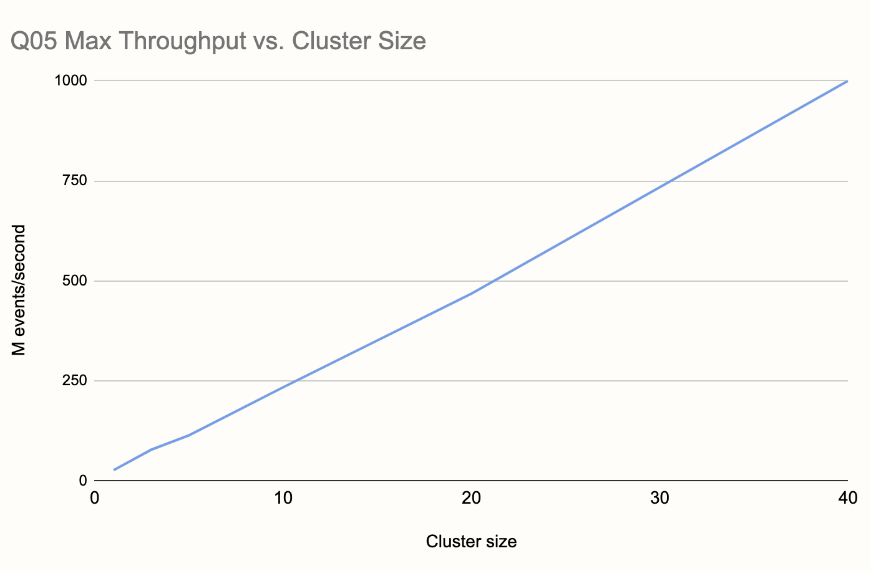
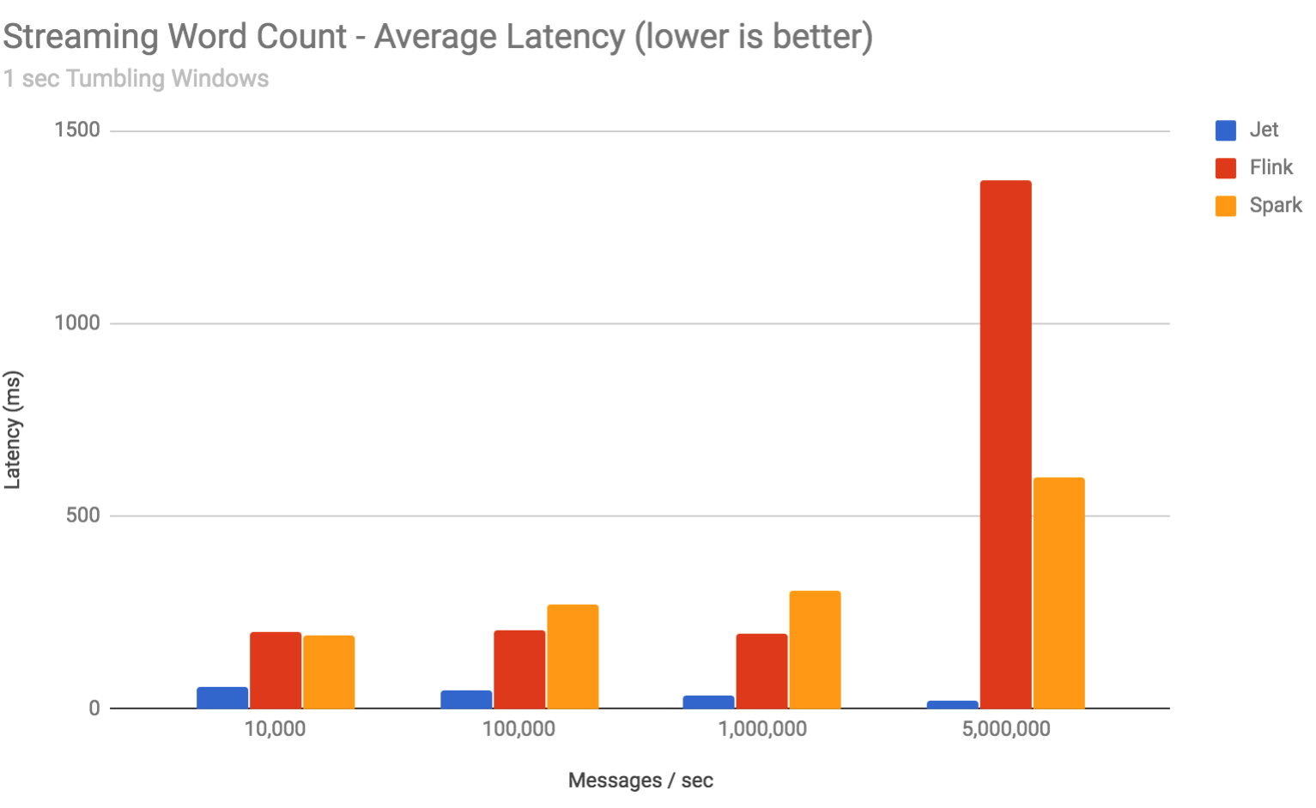
Gigascale Real-time Data Processing
1 BILLION TPS with 99% under 30ms latency
45 nodes
Linear scaling with predictable latency

Slide 22


Real-Time Streaming Analytics
Example use cases:
Personalized recommendations
Real-time offers
Payment processing
Message Bus
Apache Kafka / Apache Pulsar
Data Sources
Publisher Apps
Processing/ Analytical Apps
Subscriber Apps
Data Sinks
Notes:
This is a typical real-time, streaming analytics architecture:
Backend data being published through applications into message buses like Apache Kafka or Pulsar
subscriber apps read from the message bus and push to other applications.
Good use cases:
Personalised recommendation
Real-time offers
Payment processing

Slide 23

On-Demand, Near-Real-Time Analytics
The Hazelcast Platform
High Speed Ingest / Filter
Data Mart
(Raw and Aggregated Data)
Results Drill-Down UI
(Web App Server)
Enterprise Data
High Speed Ingest / Aggregate / Index
Data Sources (e.g., databases, Kafka, Kinesis, applications)
Submit query
Cancel query
On-Demand Aggregation Query UI
Hazelcast Management Center

Slide 24


Architecture – Scale Ingest/Data/Compute/ML
Data Processing
Streaming Ingest
Live Events
Queries, Logic &
Machine Learning
Event Stream Input
Analytics
Source
Queries, Logic &
Machine Learning
Streaming Ingest
Live Events
Analytics
Source
Queries, Logic &
Machine Learning
Streaming Ingest
Live Events
Analytics
Sink or Client App
Source
Queries, Logic &
Machine Learning
Streaming Ingest
Live Events
Analytics
MLOps Runtimes
Linear Scaling
Peer-to-Peer Architecture
Single Jar
Notes:
One way you can use Hazelcast IMDG and Jet together is by having them scale together, where one Jet instances feeds into one IMDG instance,
This works well for smaller environments where simplicity is most important than scaling flexibility.

Slide 25
Machine Learning Inference
The Hazelcast Platform
In-Memory Storage
Event Source
(Kafka, IoT, etc.)
Stream Processing Pipeline
Streaming events (transactions, etc.)
Machine Learning Models
(Python*, C++, etc.)
Clients
(Microservices)
Notes:
Hazelcast enables you to deploy as many models into production due to its performance and scalability.
Deploying models in a separate cluster is much slower - running within the HZ pipeline results in huge performance advantage
When you have use cases where performance is critical, like the following:
Fraud detection
Industrial ops optimisation
Driver analytics
Predictive maintenance - reference Sigma Stream

Slide 26

Python Models
The Hazelcast Platform
ML Scoring 1
Inference Runner
Kafka / Pulsar
Ingest 1
Transform Tasks
Transform Tasks
Deliver 1
…
…
Python VM
…
…
Python Code
…
Python Code
…
ML Scoring N₁
…
Job Submission
…
Inference Runner
…
Ingest N₀
Deliver N₂
…
…
File System Folder
Python VM

Slide 27
Stream Processing Deployment Choices
Remote Deployment
stream processing cluster
Local Deployment
Message Broker (Kafka)
Combined in-memory store and stream processing cluster
Data Enrichment
Source /
Enrichment
Sink
Enrichment
in-memory store cluster
Sink
Good when:
You desire simpler, integrated deployments
You need the absolute lowest latency
in-memory store and stream processor have equivalent sizing needs
Good when:
Data-at-rest needs to access the in-memory store RAM pool
You want to independently scale compute and storage
Notes:
Jet is build on top of Hazelcast with the benefits of close integration. Hazelcast Jet and can run in these deployments:
Every Jet cluster works on top of embedded Hazelcast in-memory data grid. Embedded deployment suits well for:
Sharing processing state among Jet nodes
Caching intermediate processing results
Enriching processed events. Cache remote data (e.g. fact tables from database) on Jet nodes.
Running advanced data processing tasks on top of Hazelcast data structures
Development purposes. Since starting standalone Jet cluster is simple and fast.
Remote deployment
Share state or intermediate results among more Jet jobs
Cache intermediate results (e.g. to show real-time processing stats on dashboard)
Load input or store results of Jet computation in in-memory fashion to
Isolation of processing and storage layer
Jet x – product differentiation
Both Jet and are for parallel and distributed computing, why Jet is more expensive? Is Hazelcast IMDG not good enough?

Slide 28
Demo

Slide 29
Demos
Stream Processing (Embedded)
Stream Processing (Client/Server)
SQL Over Kafka

Slide 30
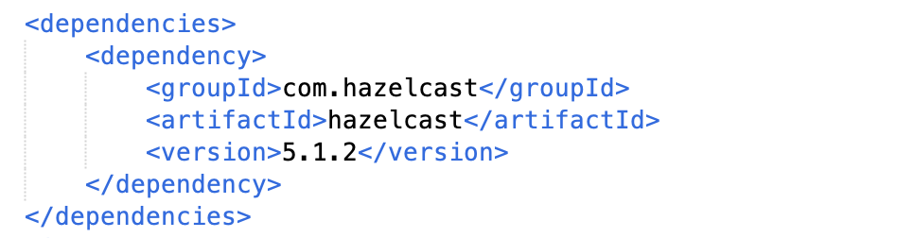
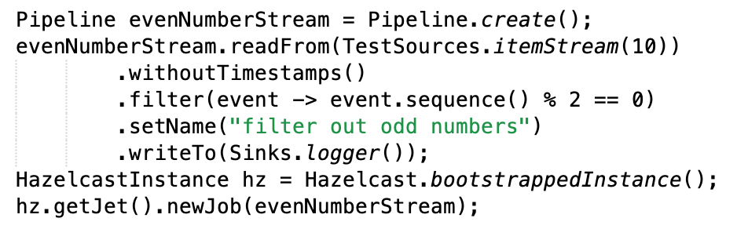
Stream Processing (Embedded)
Maven project
Build a pipeline

Slide 31
Stream Processing (Client/Server)
Start a Hazelcast Member
docker run -it --network hazelcast-network --rm -p 5701:5701 hazelcast/hazelcast:5.1.2
Submit your Job to the Member
docker run -it --network hazelcast-network -v /Users/fghali/NetBeansProjects/istanbulcoders/target:/jars --rm hazelcast/hazelcast:5.1.2 hz-cli -t 172.18.0.2 submit -c com.hazelcast.istanbulcoders.ClientServer /jars/ic-1.0-SNAPSHOT.jar
Monitor your Jobs in Management Center
docker run --network hazelcast-network -p 8080:8080 hazelcast/management-center:latest-snapshot

Slide 32
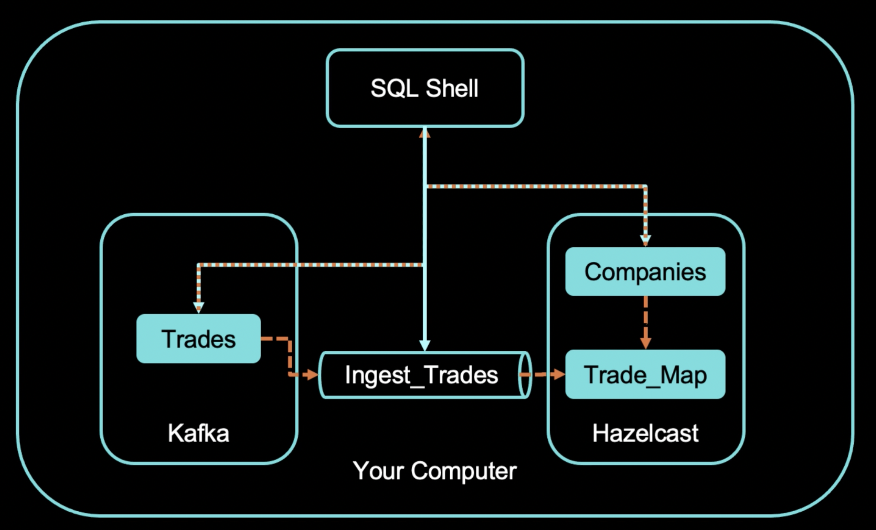
SQL Over Kafka

Slide 33
SQL Over Kafka
A Hazelcast cluster in client/server mode
A connection to the SQL shell
Set Up a Kafka Broker
Create a Mapping to Kafka
Run a Streaming Query on the Kafka Topic
Enrich the Data in the Kafka Messages
Ingest Query Results into a Hazelcast Map
Cancel the Job

Slide 34
Best Practices
Ingest data in real-time in any format
Use SQL to analyze data in real-time
Minimizing disk I/O by caching your data at scale
Use real-time data for multiple purposes
Focus on simplifying your code
Think if you need a zero downtime
Avoid the enemies (if you can)

Slide 35
Enemies of Stream Processing
Network Hops
Storage I/O
Processor – “Context Switching”
Excessive or Unnecessary “Staged” Elements to Architecture
Data Enrichment Requiring Added Data Retrieval

Slide 36
Give It a Try or Learn More
Try Hazelcast
https://hazelcast.com/get-started/
https://cloud.hazelcast.com/sign-up
Learn More
Docs: https://docs.hazelcast.com/home/index.html
Training: https://training.hazelcast.com/
Blogs: https://hazelcast.com/blog/

Slide 37
Join the Hazelcast Developer Community
Slack: Join the Hazelcast Community on slack to chat with users and developers of Hazelcast.
Local events: Speak at or meet the Hazelcast Local community
Twitch live streams: Live sessions, interviews, office hours
Community Blog: Write about your experience or read how other developers use Hazelcast
Hazelcast Heroes: Become a Hazelcast Hero (or even a Hazelcast employee)
Email: developer-relations@hazelcast.com

Slide 38
Hazelcast is Hiring!
Solutions Architect - Remote
Product Manager
Senior Product Manager
Software Engineer
Senior Software Engineer
Senior Site Reliability Engineer
Check: https://hazelcast.com/company/careers/

Slide 39
Scan QR Code to Win $100 Gift Voucher

Slide 40
Thank you! Q&A
Fawaz Ghali – Developer Advocate
@fawazghali

